Slide 1
Plexus GCC Interworking
Dillon Feng
x5268

Slide 2
Agenda
  Plexus Background
  Plexus Architecture
  GCC Introduction
  GCC State Machine
  GCC Protocol Interworking
  GCC Redundancy

Slide 3
Agenda
  Plexus Background
  Plexus Architecture
  GCC Introduction
  GCC State Machine
  GCC Protocol Interworking
  GCC Redundancy

Slide 4


Plexus Background
  Traditional PSTN Network
AIN
Services
AIN
SS7
Network
Class 4
Switch
Embedded
Services
Class 5
Switch
Class 5
Switch
Embedded
Services
TDM
Transport
Embedded
Services

Slide 5











Plexus Background
  NGN Network
    Consolidated Softswitch model
    IMS model
Wireless
App
Servers
App
Servers
Subscriber
Data
App
Servers
Subscriber
Data
JTAPI, Parlay,
& Proprietary
App
Servers
Wireline
Subscriber
Data
SIP
XML
Embedded
Services
Session Control
CSCF
Call Control
SIP
SIP
MGCF
Signalling
Gateway
Signalling
Gateway
Media GW Controller
Media GW Controller
SIP, H.323,
& MGCP
H.248/MEGACO
H.248
Media
Gateway
Media
Gateway
IP
IP
IP
Endpoints
Analog
Circuit Wireless
Analog
Circuit Wireless
SIP Endpoints

Slide 6


Plexus Background
  IMS goal
    Whole IP based network
    Upgrade the exiting PSTN network
SIP
Access
AS
Home
Network
AS
DNS
ENUM
HSS
AS
RTP
Diameter
RTP
SIP
SIP
Backbone
Packet
Network
P-CSCF
SIP
I-CSCF
SIP
S-CSCF
SIP
MRFC
Visited
Network
SIP
MS
MS
SIP
SIP
SIP
BGCF
SIP
MGCF
ISUP
H.248
SS7
PSTN
RTP
MGW
TDM

Slide 7
Plexus Background
  Lucent need one bridge for IMS and Traditional network
    Plexus is coming
      Provide Class 5 services (3.x load)
      Provide Class 4 services (6.x load)

Slide 8
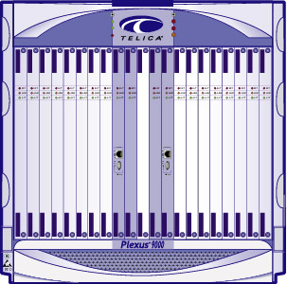
Plexus Configuration
Fully Distributed Configuration
Lucent Network Controller w/Signaling Gateway
SG
SG
NC
Lucent Compact Softswitch
SG
NC
NG
NC
NG
Best Flexibility
Best Scalability
Best Position for
Future Growth
Lucent
Network
Gateways
NG

Slide 9
Agenda
  Plexus Background
  Plexus Architecture
  GCC Introduction
  GCC State Machine
  GCC Protocol Interworking
  GCC Redundancy

Slide 10
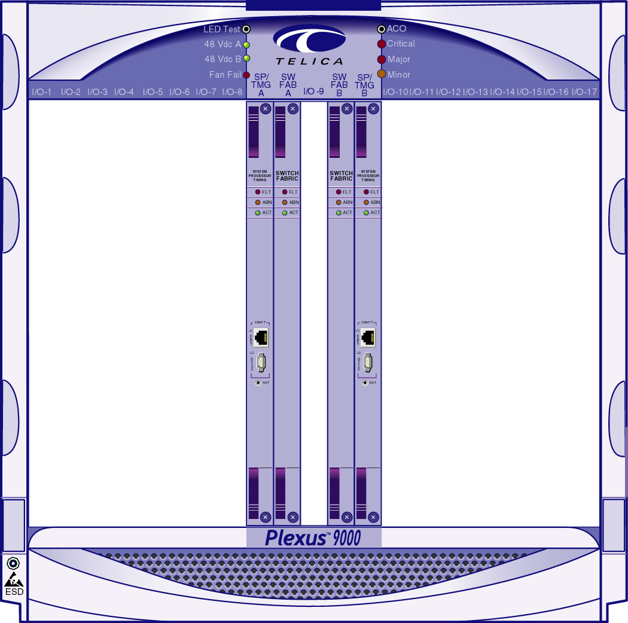
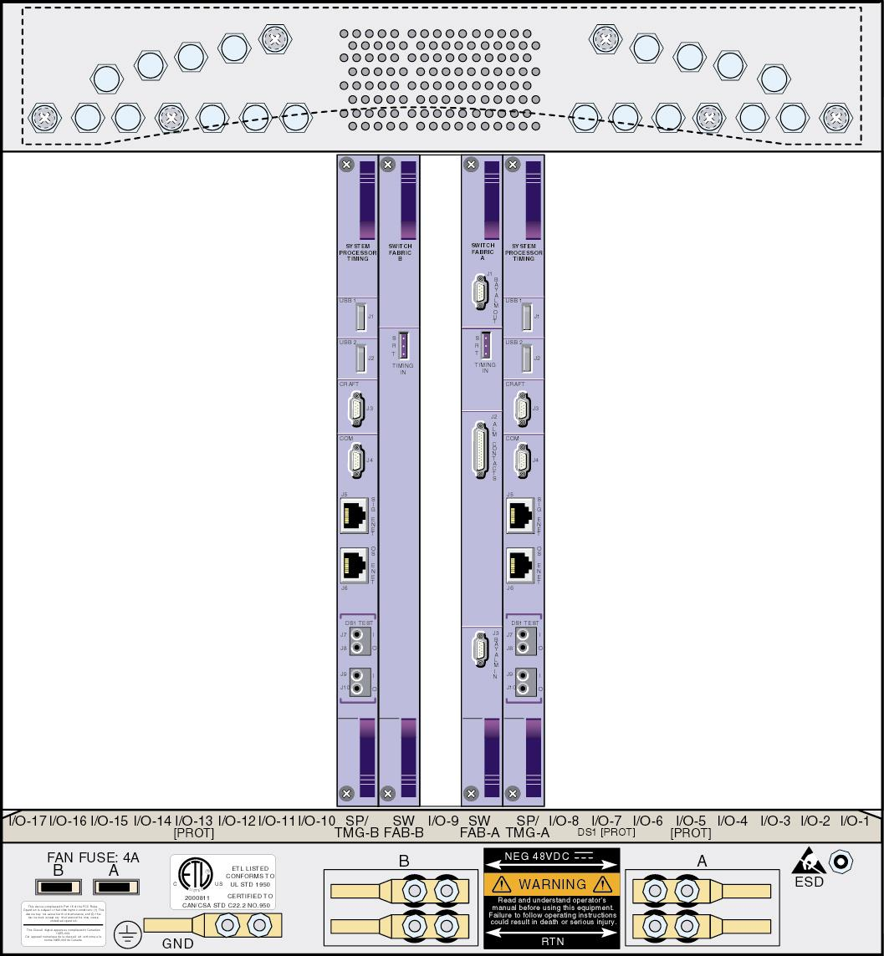
Plexus Architecture
  Hardware architecture

Slide 11
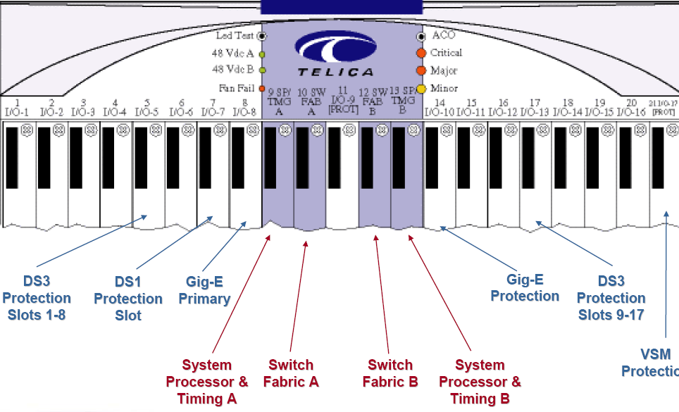
Plexus Architecture
  Hardware front view

Slide 12
Plexus Architecture
  Hardware Protection

Slide 13
Plexus Architecture
  Software architecture
    MGC+SG+MG
    MGC
    MG
    SG
    MGC+SG
    SG+MG

Slide 14
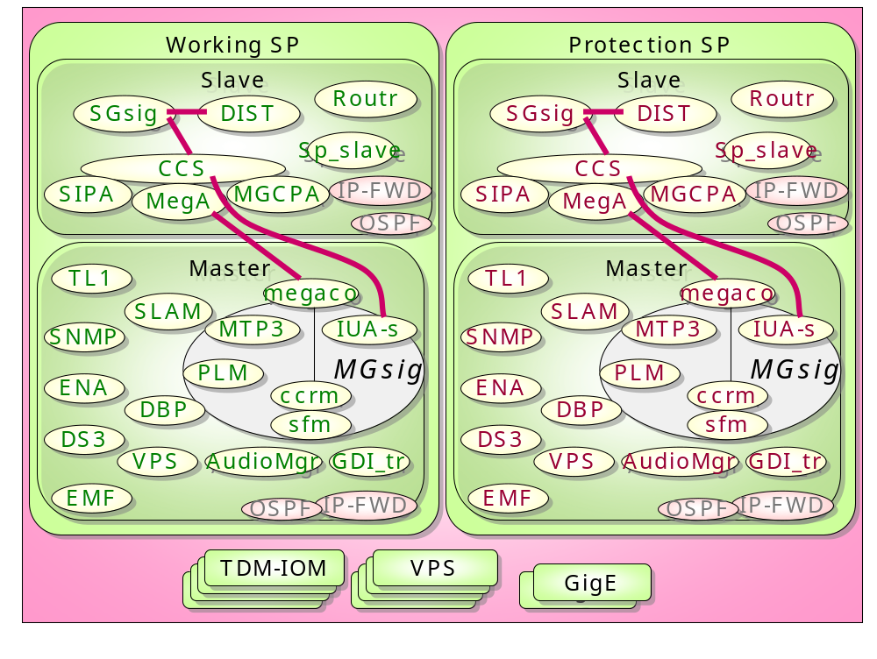
Plexus Architecture
  Compact switch

Slide 15
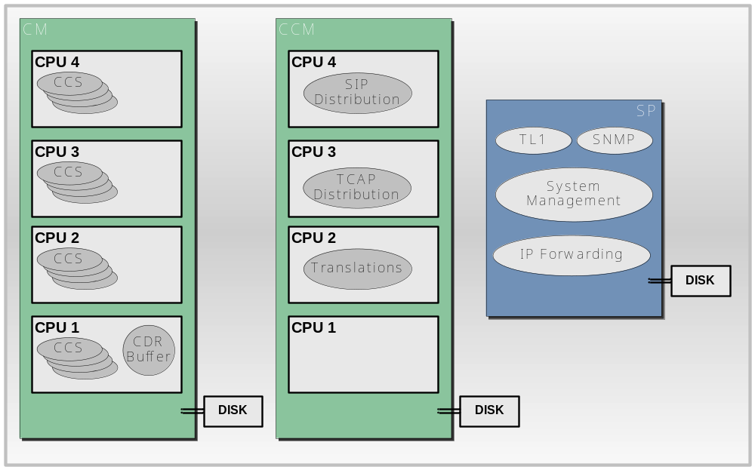
Plexus Architecture
  Fully distribute switch
    MGC

Slide 16
Plexus Architecture
  Message distribution (IP)
  Message distribution (TDM)?
Decode Port to forward to configured CCS
SP-slave
IP Forwarding
CM-n
CM-m
CCS
CCS
CCS
CCS
CCS
CCS
CCS
CCS

Slide 17
Agenda
  Plexus Background
  Plexus Architecture
  GCC Introduction
  GCC State Machine
  GCC Protocol Interworking
  GCC Redundancy

Slide 18
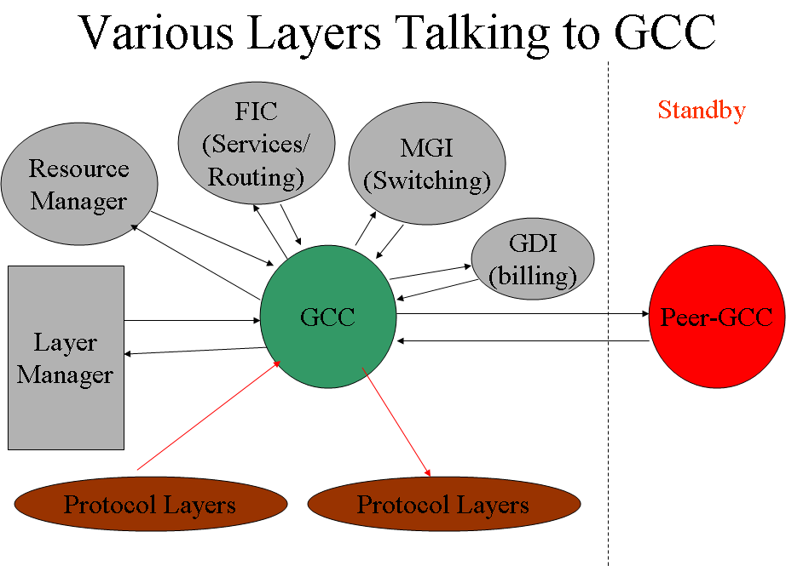
GCC Introduction
  GCC
    Generic Call Control
    One bridge from one protocol to the other
    Routing call
    redundancy
    ……

Slide 19
GCC Introduction
  GCC
    Signaling Layer
    PSIF-X
    Routing Server
    FIC (service)
    Billing Server
    ……
Router
FIC
FIC
GCC
GCC
PSIF-X
PSIF-X
Signaling X
Signaling X
MGCP
ISDN
CAS
303
ISUP
BICC
SIP
MGCP
ISDN
CAS
303
ISUP
BICC
SIP

Slide 20
GCC Introduction
  Call Type
    Intra-CCS call
    Inter-CCS call/Inter-CM call
  Internal-BICC
    As the queue between CCS

Slide 21
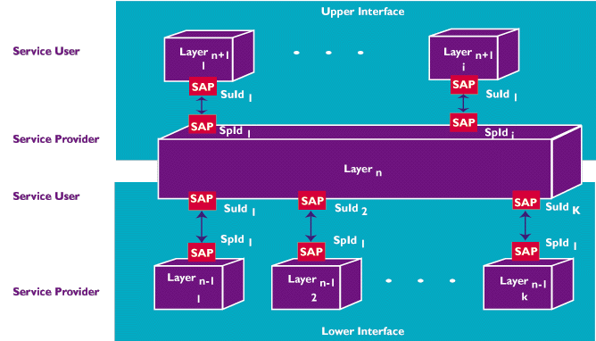
GCC Introduction
  Layer Communication

Slide 22
GCC Introduction
  Plexus Layer Communication
Task activation
(unpack message
receiver function)
Layer n
Loosely coupling
System
Services
Tight coupling
(Direct Call)
Tightly coupling
Loose coupling
(pack & post)
Interface
module
Note: System services hides details of whether Layer N resides in same or another task/process/processor.
Layer n-1

Slide 23
GCC Introduction
  Plexus Layer Communication
    Tightly coupling
      Function Call
    Loosely coupling
      IPC
      Interface can be socket, message queue or shared memory
      Easily for distributed system

Slide 24
GCC Introduction
  Plexus Layer Communication
    Upper/lower layer call
    functionA(xx, xx)
    {
    ……
    ret = (*ccLiCctConReqMt[pst->selector])(pst, spId, suConnId, rsc,
    protType, ccConEvnt, uBuf);
    reEntryFlag = FALSE;
    ……
    }

Slide 25
GCC Introduction
  Plexus Layer Communication
    Implementation
    PUBLIC CONSTANT CctConReq ccLiCctConReqMt [MAXCCLICCT] =
    {
    #ifdef LCCCLICCT
    cmPkLiCctConReq, /* 0 - loosely coupled - fc */
    #else
    PtUiCctConReq, /* 0 - tightly coulpled, portable */
    #endif
    PtUiCctConReq, /* 1 - tightly coupled, portable */
    IwUiCctConReq, /* 2 - tightly coupled, isup */
    QwUiCctConReq, /* 3 - tightly coupled, isdn */
    PtUiCctConReq, /* 4 - tightly coupled, portable */
    ……
    }

Slide 26
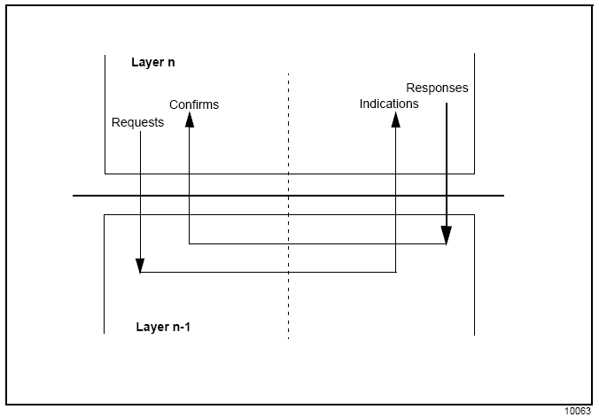
GCC Introduction
  Plexus Layer Communication Method
    Primitives
      Requests or responses (from layer n to layer n-1)
      Indications or confirms (from layer n-1 to layer n)

Slide 27
GCC Introduction
  Plexus Layer Communication Method
    Primitives
      Requests or responses (from layer n to layer n-1)
      Indications or confirms (from layer n-1 to layer n)

Slide 28
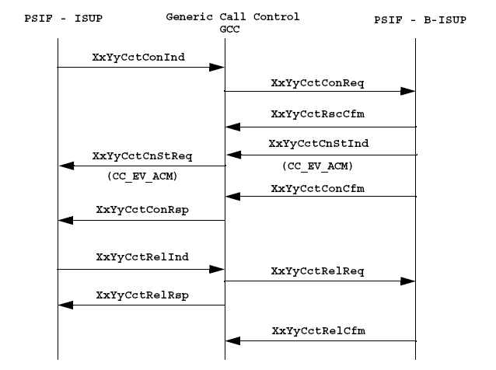
GCC Introduction
  Plexus Layer Communication Method
    Primitives
      Requests or responses (from layer n to layer n-1)
      Indications or confirms (from layer n-1 to layer n)

Slide 29
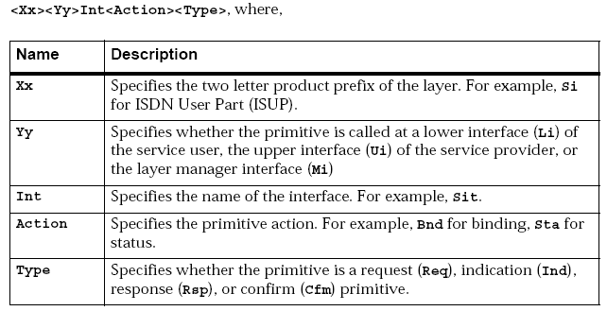
GCC Introduction
  Plexus Layer Communication Method
    Interface Naming Conventions

Slide 30
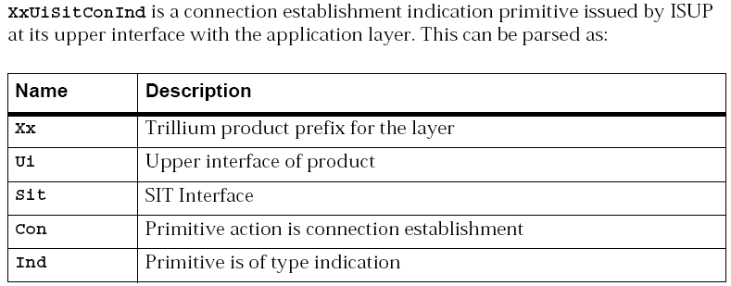
GCC Introduction
  Plexus Layer Communication Method
    Interface Naming Conventions Example

Slide 31
Agenda
  Plexus Background
  Plexus Architecture
  GCC Introduction
  GCC State Machine
  GCC Protocol Interworking
  GCC Redundancy

Slide 32
GCC State Machine
  GCC State Machine
    Event driven model
State A
State B
State C
Event X
Event X
Event X
Event Y
Event Z
Event Y
Event Z
Event Y
Event Z

Slide 33
GCC State Machine
  GCC State Machine
    State Machine Naming Conventions
      ccConEXXSXX
        Means handle Event XX at State XX.
    Example
    * Fun: ccConE00S00
    *
    * Desc: Connection state function
    * event - Connection Indication
    * state - IDLE
    * Ret: ROK - successful,
    * RFAILED - unsuccessful
    ** Notes: None.
    * File: cc_bdy2.c
    */

Slide 34
GCC State Machine
  GCC State Machine
    State Machine Table
    StateFn stateTable[CCMAXEVENTS][CCMAXSTATES] =
    {
    /* Connect indication - 00 */
    {
    ccConE00S00, /* 00-CCS_IDLE */
    ccUnexpEvent, /* 01-CCS_AWTROUTERSC */
    ccUnexpEvent, /* 02-CCS_AWTROUTEDGT */
    },
    /* Connct confirm - 01*/
    {
    ccUnexpEvent, /* 00-CCS_IDLE */
    }
    }

Slide 35
GCC State Machine
  GCC State Machine
    Upper/lower layer call
    XxYyCctStaInd
    → ccCallStateMachine (con, CCE_CONIND, (PTR)ccConEvnt, suId, spConnId,
    (PTR) NULLP, (PTR) NULLP);
    →stateTable[evntType][oldstate]
    →Mapping Function (If have)

Slide 36
GCC State Machine
  GCC State Machine
    Upper/lower layer call
    XxYyCctStaInd
    → ccCallStateMachine (con, CCE_CONIND, (PTR)ccConEvnt, suId, spConnId,
    (PTR) NULLP, (PTR) NULLP);
    →stateTable[evntType][oldstate]
    →Mapping Function ccMapEvent(con, CCE_CONIND, 0); (If have)

Slide 37
GCC Mapping Function
  GCC Mapping Function
    Message Level Mapping for protocol X to protocol Y
Protocol 1
Protocol 2
Protocol 3
GCC
Protocol n
Protocol 4
Protocol 5

Slide 38
GCC Mapping Function
  GCC Mapping Function
    Get the mapping index for each message
      Based on incoming and outgoing protocol
      Based on message direction
      Based on message type
    Example
    ccGetMappingIndex_real
    ->ccGetMappingIdx
    ->SI TO SI
    ->ccGetNBToNBMappingIdx
    ->IAM TO IAM
    ……
    or
    -> SI TO IN
    ->ccGetSIToINMappingIdx
    ……

Slide 39
GCC Mapping Function
  GCC Mapping Function
    After get Map index, call real mapping function
      Based on incoming and outgoing protocol
      Based on Mapping index
    Example
    ccGetMappingIndex_real
    ->ret = directMappingMatrix[intwIdxIc][intwIdxOg][mapIdx](con);
    ->SIPT_SI_BICC_TO_SIPT_SI_BICC
    ->ccMapS02M00 /* IAM to IAM */

Slide 40
GCC Mapping Function
  GCC Mapping Function
    For message interworking, it is NxN matrix
    Direct mapping matrix:
    PFCCM *directMappingMatrix[MAX_BASE_INTW_PROT][MAX_BASE_INTW_PROT] =
    {
    /* INTW_CAS_GR303_LN */
    {
    CAS_GR303_LN_TO_CAS_GR303_LN,/* INTW_CAS_GR303_LN */
    CAS_GR303_LN_TO_CAS_TG, /* INTW_CAS_TG */
    ……
    },
    /* INTW_CAS_TG */
    {
    CAS_TG_TO_CAS_GR303_LN, /* INTW_CAS_GR303_LN */
    ……
    }
    },

Slide 41
GCC Mapping Function
  GCC Mapping Function
    Message mapping function matrix
    Direct mapping matrix:
    PFCCM *directMappingMatrix[MAX_BASE_INTW_PROT][MAX_BASE_INTW_PROT] =
    {
    /* INTW_CAS_GR303_LN */
    {
    CAS_GR303_LN_TO_CAS_GR303_LN,/* INTW_CAS_GR303_LN */
    CAS_GR303_LN_TO_CAS_TG, /* INTW_CAS_TG */
    ……
    },
    /* INTW_CAS_TG */
    {
    CAS_TG_TO_CAS_GR303_LN, /* INTW_CAS_GR303_LN */
    ……
    }
    },

Slide 42
GCC Mapping Function
  GCC Mapping Function
    For message interworking, it is NxN matrix
    PUBLIC PFCCM SIPT_SI_BICC_TO_SIPT_SI_BICC[SIPT_SI_BICC_TO_SIPT_SI_BICC_MAX] =
    {
    ccMapS02M00, /* IAM to IAM */
    ccMapS02M01, /* ACM to ACM */
    ccMapS02M02, /* CPG to CPG */
    ccMapS02M03, /* ANM to ANM */
    ccMapS02M04, /* SUS to SUS */
    ccMapS02M05, /* RES to RES */
    ccMapS02M06, /* SAM to SAM */
    ccMapS02M07, /* FOT to FOT */
    ……
    }

Slide 43
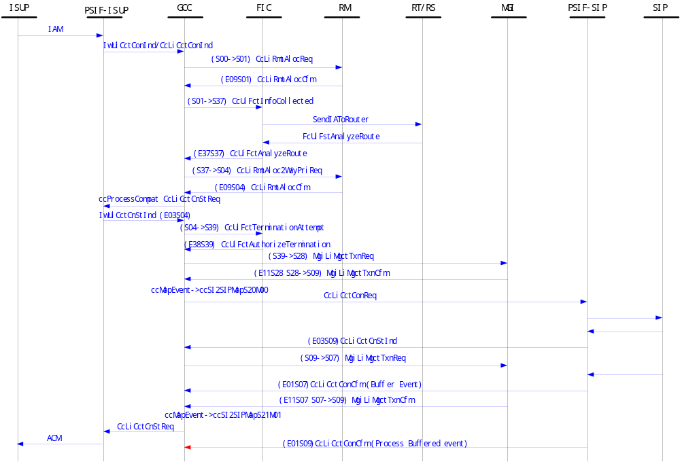
GCC Mapping Function
  GCC Basic Call Flow

Slide 44
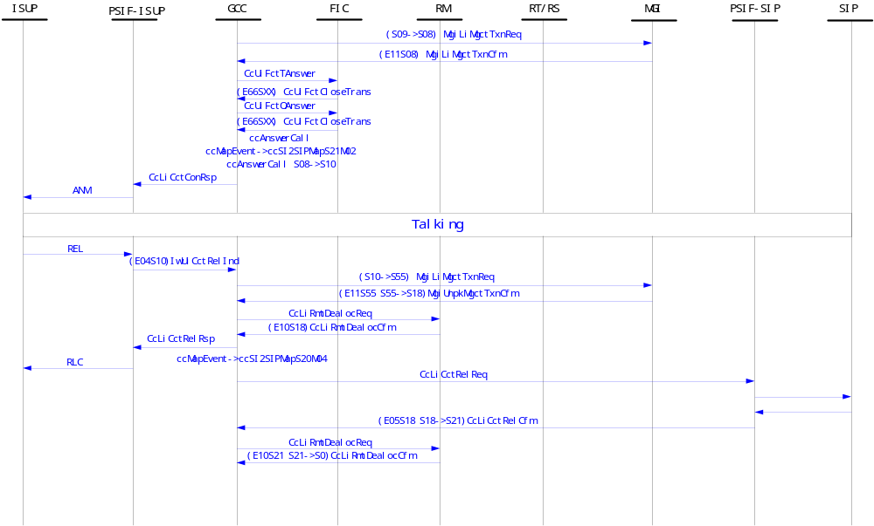
GCC Mapping Function
  GCC Basic Call Flow Cont

Slide 45
GCC Mapping Function
  GCC Basic Call Flow Cont
    Reference: ..\..\..\work\backup\new work\china isup\plexus-callflow.vsd

Slide 46
Agenda
  Plexus Background
  Plexus Architecture
  GCC Introduction
  GCC State Machine
  GCC Protocol Interworking
  GCC Redundancy

Slide 47
GCC Protocol Interworking
  Direct Mapping
    Traditional Protocol Interworking method
    Protocol X direct mapping to Protocol B
Protocol 1
Protocol 2
Protocol 3
Protocol 4
Protocol n
Protocol 5

Slide 48
GCC Protocol Interworking
  Direct Mapping Analysis
    Mapping Path
      Interworking path number will increase non-linearly
      The interworking path number will be 1/2n(n-1) for n protocol
    Standards
      No specific stands for all interworking path
    Effort
      Adding one country, N-1 interworking path will be added
      One country variant parameter changed, N-1 interworking need to be considered
      Testing, development and maintenance effort will be huge
    Reuse
      None existing interworking path can be reused
    System Stability
      System stability will be highly decreased

Slide 49
GCC Protocol Interworking
  Indirect Mapping
    Plexus new interworking method, introduced from 6.2.1
    Protocol X mapping to Protocol B via common protocol
Non-ISUP
Protocol1
Protocol 1
Protocol 2
Non-ISUP
Protocol 3
Protocol 3
Q.767
Protocol 4
Protocol 5
Protocol n

Slide 50
GCC Protocol Interworking
  Indirect Mapping Analysis
    Mapping Path
      Interworking path number will increase linearly
      The interworking path number will be n for n protocol
    Standards
      Just need to find one standard for each country and common protocol
    Effort
      Adding one country, only 1 interworking path need to be added
      One country variant parameter changed, only 1 interworking need to be considered
      Testing, development and maintenance will be easy
    Reuse
      Can reuse all the existing interworking path
    System Stability
      System stability almost no change

Slide 51
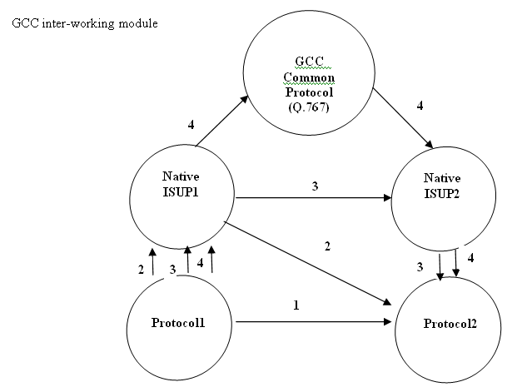
GCC Protocol Interworking
  GCC Indirect Mapping

Slide 52
GCC Protocol Interworking
  GCC Indirect Mapping
    ccMapEvent_real
    ->ccGetMapTblEntry
    checking mapping table to find is protocol A and B direct mapping or not
    Yes, follow old logic
    NO ->ccComputeIntwPath
    Example
      ISDN<-->China ISUP<-->enhanced Q.767<-->ANSI ISUP<-->SIP

Slide 53
GCC Protocol Interworking
  GCC Indirect Mapping Table
    Native ISUP Table
    PUBLIC Void ccInitNatIsupTbl
    (
    Void
    )
    {
    /* CC_IN */
    CC_INSERT_NATISUP(CC_INETSI, CC_SIETSI);
    CC_INSERT_NATISUP(CC_INNI2, CC_SIANS92);
    CC_INSERT_NATISUP(CC_INITU, CC_SIITU92);
    CC_INSERT_NATISUP(CC_CS_LN, CC_SIANS92);
    CC_INSERT_NATISUP(CC_CS_TG, CC_SIANS92);
    ……
    }

Slide 54
GCC Protocol Interworking
  GCC Indirect Mapping Table
    SI Mapping Table
    PUBLIC Void ccInitSI_TO_MapTbl
    (
    Void
    )
    {
    CC_INSERT_MAPTBL(CC_SIITU92, CC_SIITU92);
    CC_INSERT_MAPTBL(CC_SIITU92, CC_SI76792);
    CC_INSERT_MAPTBL(CC_SI76792, CC_SIITU92);
    CC_INSERT_MAPTBL(CC_SI76792, CC_SI76792);
    CC_INSERT_MAPTBL(CC_SI76792, CC_SIANS92);
    CC_INSERT_MAPTBL(CC_SI76792, CC_SIETSI);
    CC_INSERT_MAPTBL(CC_SI76792, CC_SIFTZ);
    ……
    }

Slide 55
Agenda
  Plexus Background
  Plexus Architecture
  GCC Introduction
  GCC State Machine
  GCC Protocol Interworking
  GCC Redundancy

Slide 56
GCC Redundancy
  GCC Redundancy
    Compact switch
      Each SP has one CCS
      CCS fault cause SP failover
    Distributed switch
      Each CM has 8 CCS
      Any CCS fault cause CM failover
    In General, GCC is card level redundancy, not process
    Call processing data will replicate to standby after talking.
    Configuration data stored in DB handled by DB redundancy

Slide 57
GCC Redundancy
  GCC Hot Upgrade
    Cold Upgrade
      All standing call will fail
      All new attempt call will fail
    Hot Upgrade
      All standing call will no impact
      Part of new attempt call will fail (Very limit)

Slide 58
GCC Redundancy
  GCC Hot Upgrade
    Why can hot upgrade
      First upgrade standby card with new version load
      The old version master load, replicate data to new version
      Standby load check incoming data version
        Same with own – no more action
        Different version – call the related unpack function
        For new data, set to initialize value
      After new version is ready
        Switch over
        Upgrade the other old load
        Two side version is same

Slide 59
GCC Redundancy
  GCC Hot Upgrade
  Example
    PRIVATE S16 zcUnpkRtCreateConCb(pst, tabType, updType, mBuf)
    {
    ……
    if (version == peerVersion)
    {
    zcUnpkStructFn(pst, tabType, updType, size, (PTR)&createConCb, mBuf)) != ROK)
    }
    else
    {
    size = sizeof (ZcRtCreateConCb_v_1_1);
    if ((ret = zcUnpkStructFn(pst, tabType, updType,
    size, (PTR)&createConCb_v_1_1, mBuf)) != ROK)
    }

Slide 60
Question & Answer
Thanks

